Slide 1
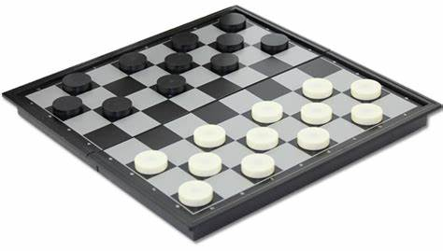
Draught
CS181 Final Project
周守琛 叶柯成 张郅睿 王鹏豪

Slide 2
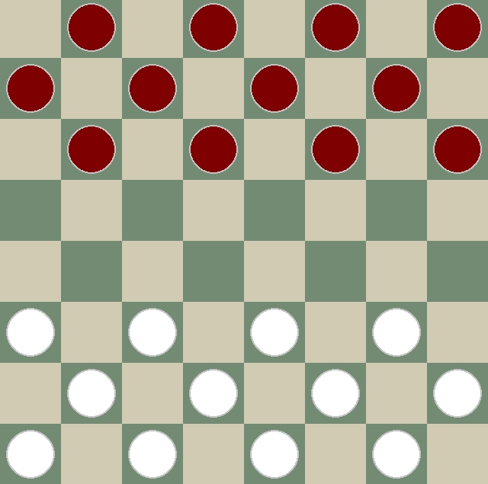
Settings
8*8 grids
24 pieces (12 per side)
5^32 ≈ 10^22 states

Slide 3
Implement methods
Random
Greedy
Adversarial search (minimax, alpha-beta pruning)
Reinforcement learning
MCTS
Q-learning
Approximate Q-learning

Slide 4
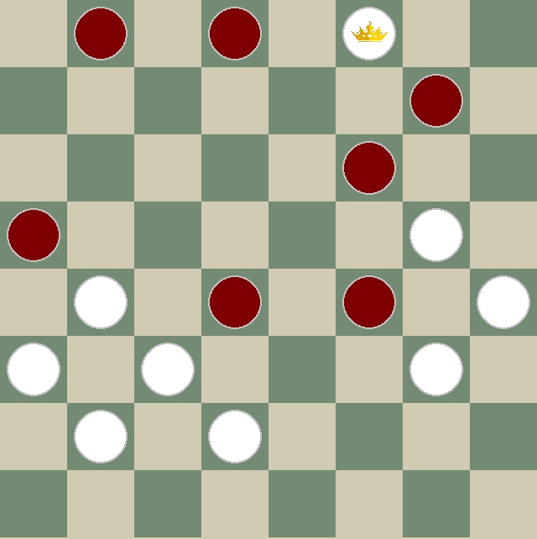
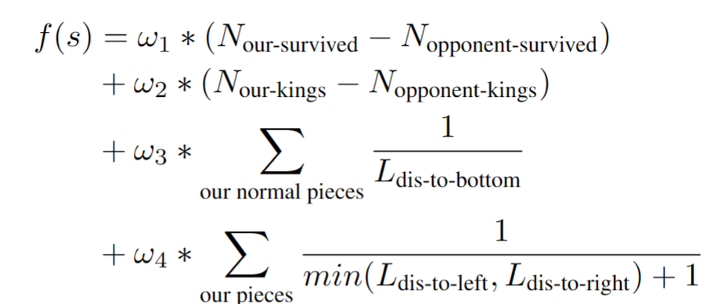

Score function

Slide 5
Basic methods
Random
Greedy
Adversarial search (minimax, alpha-beta pruning)

Slide 6
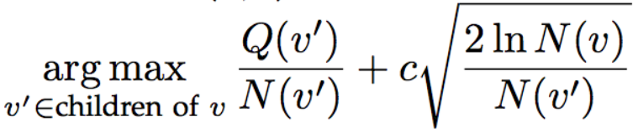
Monte-Carlo Tree Search
UCT
Exploitation
Exploration

Slide 7
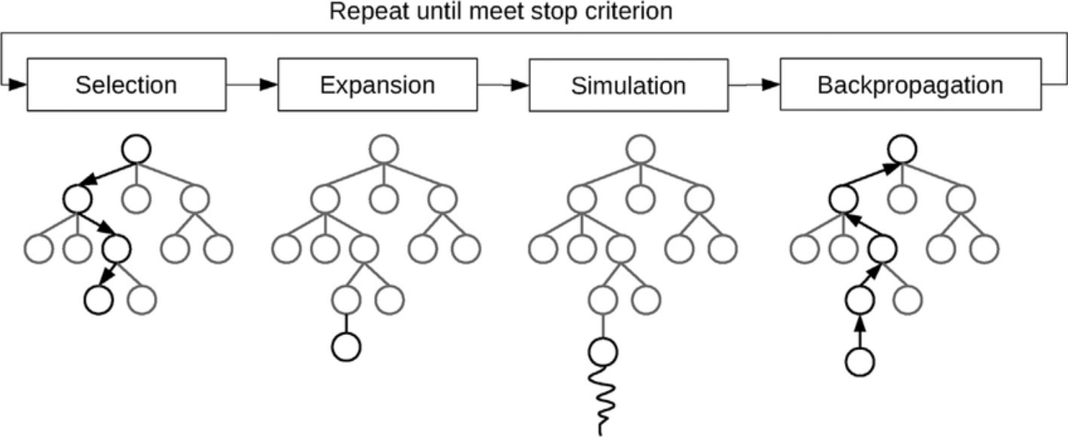
Monte-Carlo Tree Search

Slide 8
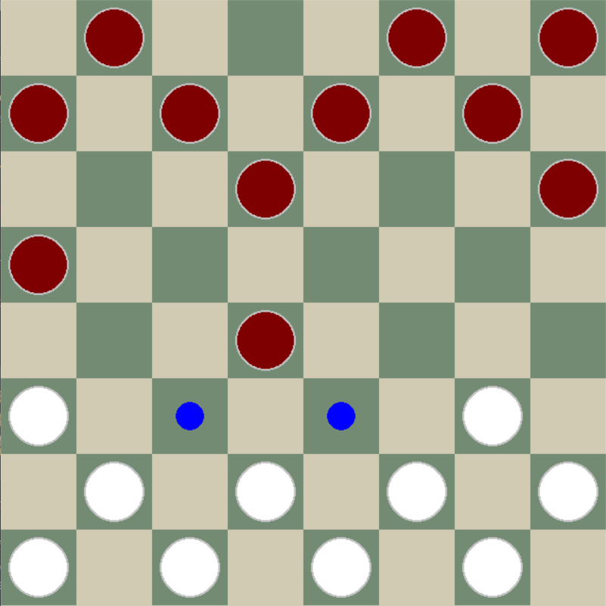
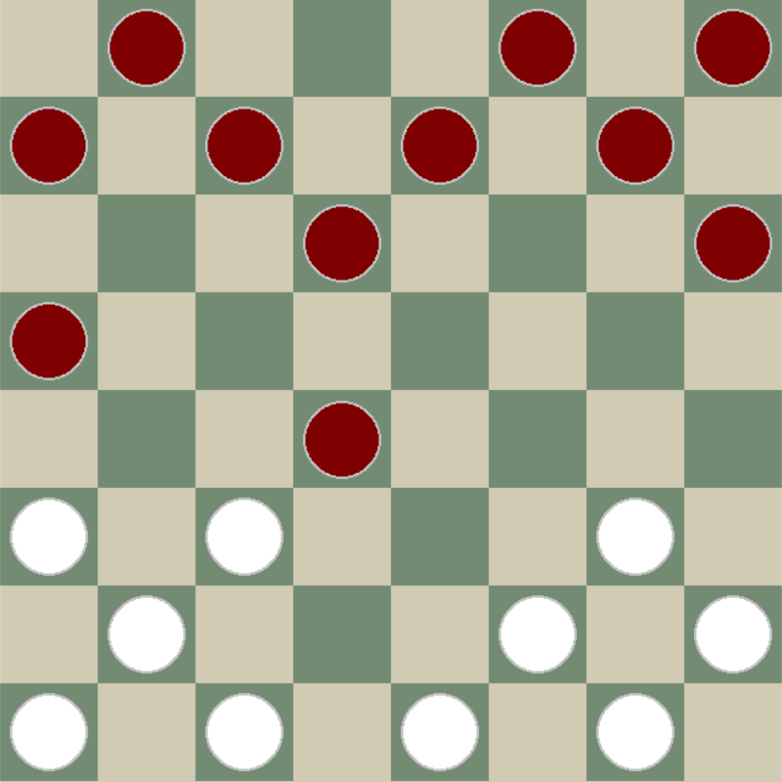
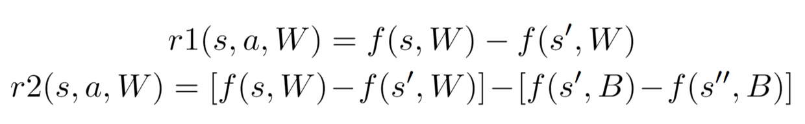
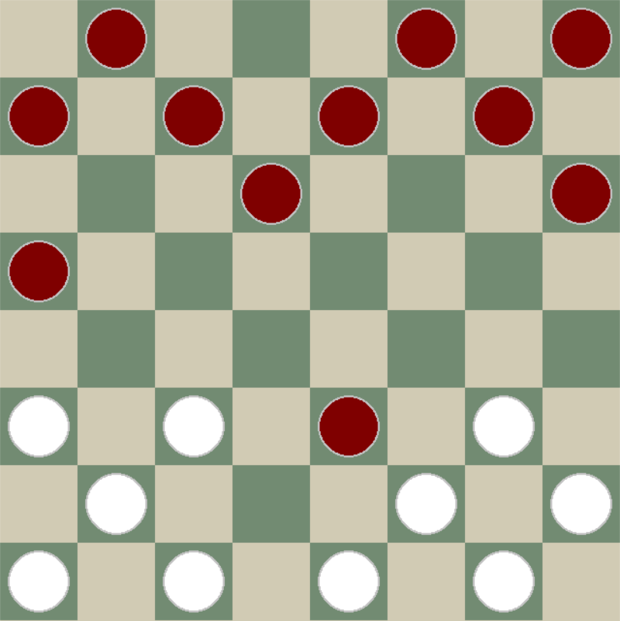
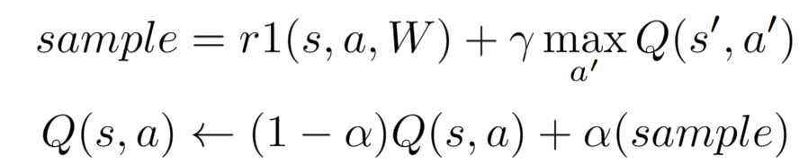
Q-learning
s
s’
s’’

Slide 9
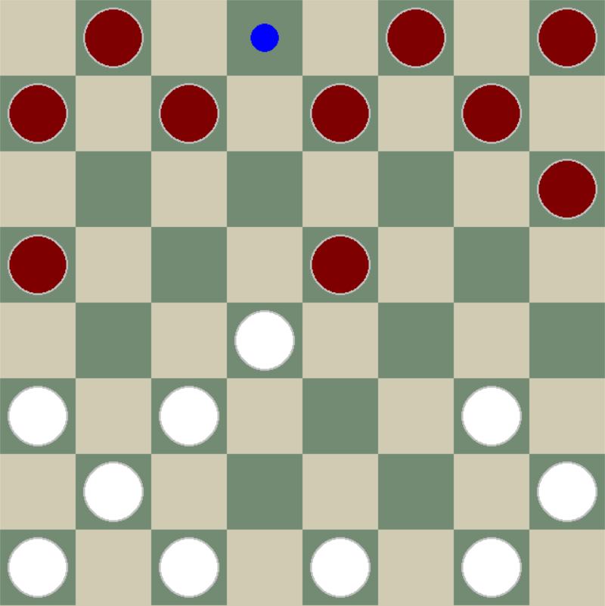
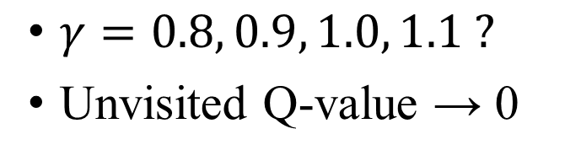
Q-learning
$γ=0.8, 0.9, 1.0, 1.1 ?$
Unvisited Q-value → 0

Slide 10
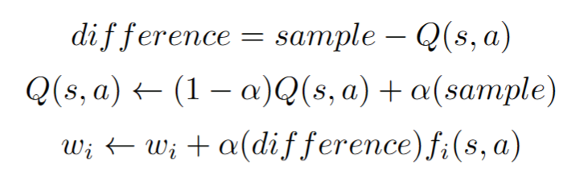




Approximate Q-learning
$$f_{1}$$
$$f_{2}$$
$$f_{3}$$
$$f_{4}$$

Slide 11
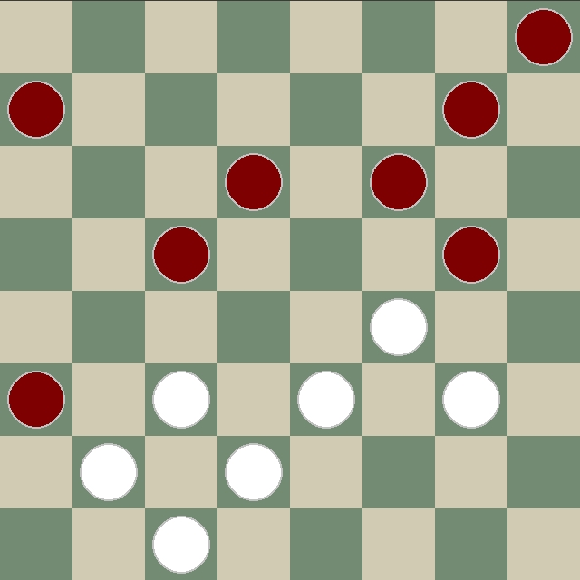
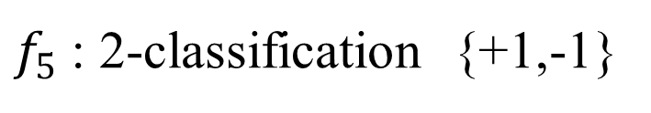
Approximate Q-learning
5x5 conv
ResNet101
Output
Input
Turn
white/black
(0/1)
FC
$f_{5}$: 2-classification {+1,-1}

Slide 12
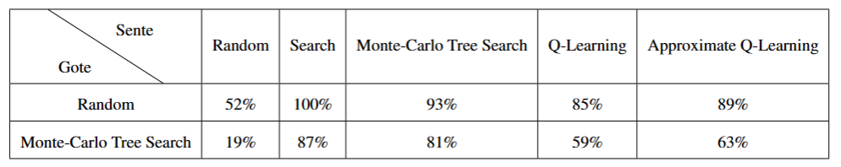
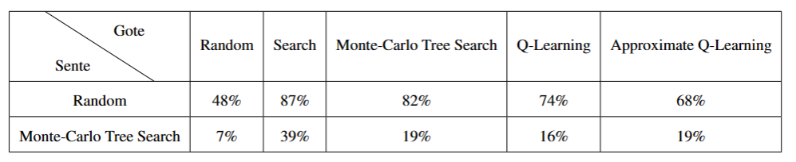
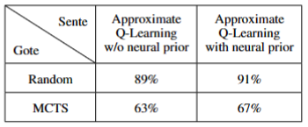
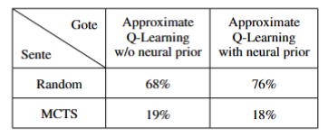
Results
Sente:先手
Gote :后手

Slide 13
Thank you

